Slide 1
TOPIC-HR DATA ANALYSIS
NAME-SANJAY SHOME
BATCH 1 AT23

Slide 2
BUSINESS OBJECTIVE
To optimize human resources management practices and enhance organizational performance by leveraging data-driven insights to inform talent acquisition, employee engagement, retention strategies, and workforce planning initiatives.
Our primary aim is to increase employee productivity and satisfaction while reducing turnover rates by analyzing HR data to identify trends, patterns, and factors influencing employee performance and satisfaction.

Slide 3
DATA DRIVEN QUESTION
Data cleansing involves removing unnecessary columns.
Giving the columns new names.
Eliminating redundant entries.
Santitzing specific columns.
Eliminating the dataset’s NaN values.
Look for a few more changes if necessary.

Slide 4
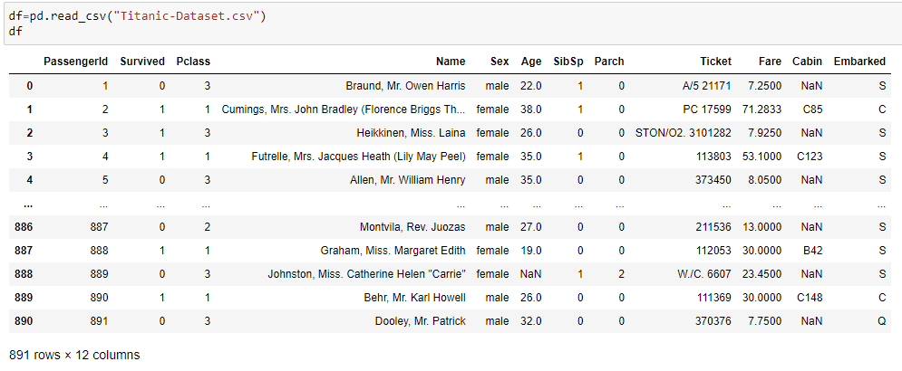
Basic information and understanding about the data

Slide 5
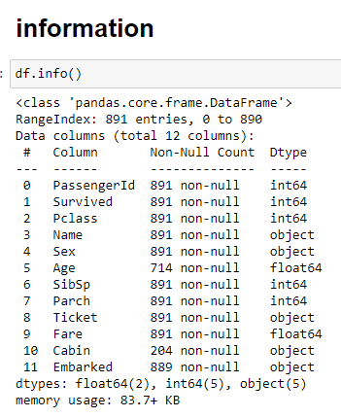
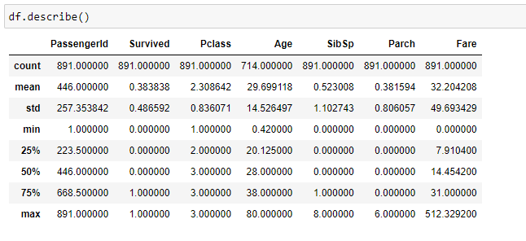
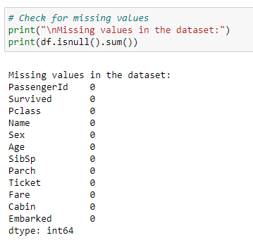
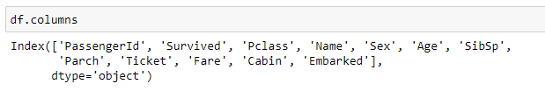

Slide 6
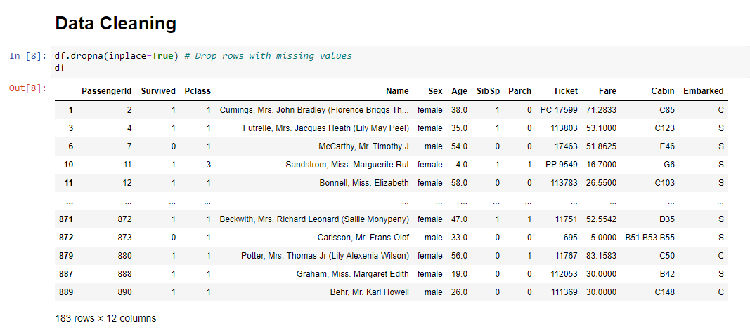
1) Data cleaning involves removing uncessary columns

Slide 7
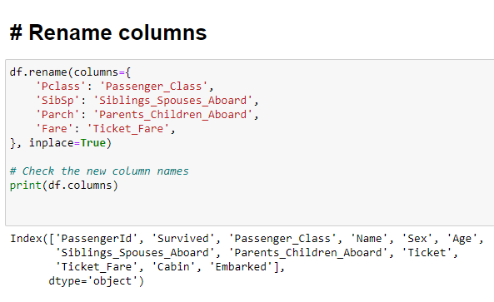
2) Giving the columns new names

Slide 8
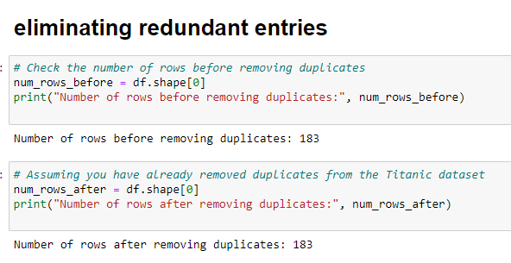
3) Eliminating Redundant entries

Slide 9
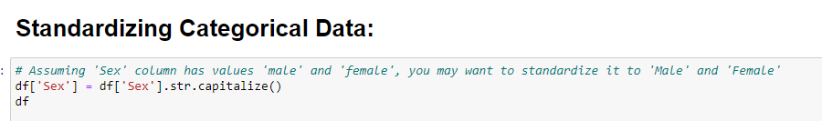
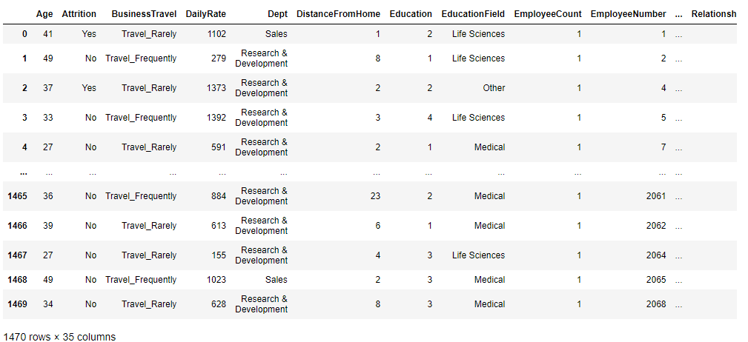
4) Sanitizing specific columns

Slide 10
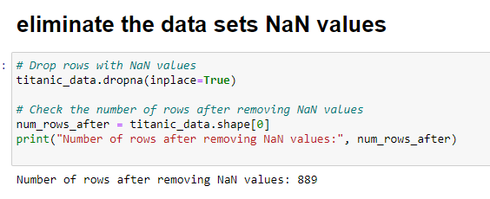
5) Eliminate the data set’s NaN values.

Slide 11
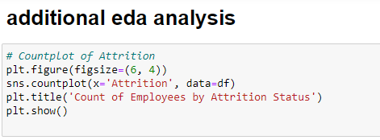
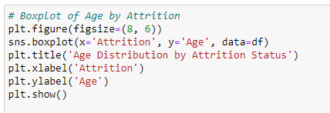
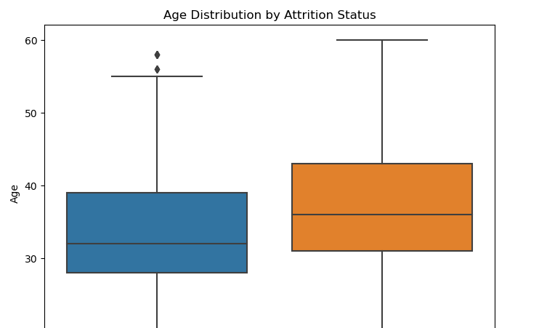
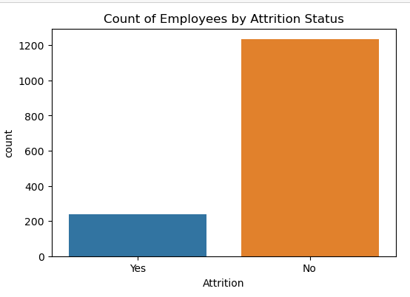
6) Look for a few more changes if necessary

Slide 12
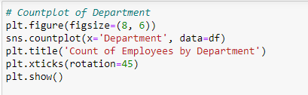
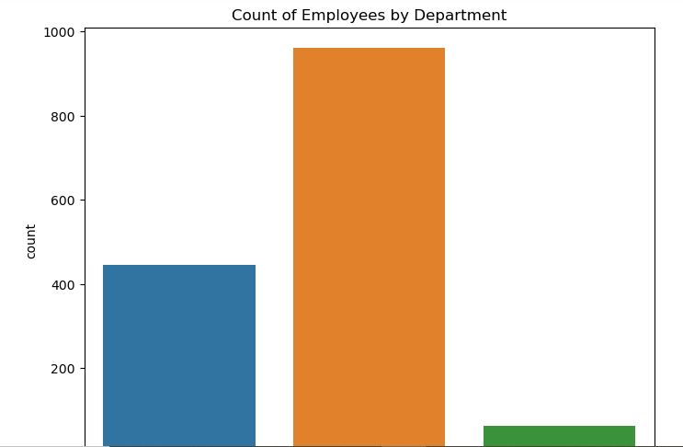

Slide 13
THANK YOU

